Slide 1
Introduction to Git and GitHub

Slide 2
1. Introduction

Slide 3
Session outline
Introduce Git and GitHub and explain the benefits of using them.
Explain the concepts underpinning Git and GitHub.
Demonstrate the basic Git and GitHub workflows using both the RStudio graphical interface and the command line.
Exercise
Mention some more advanced features that you are likely to come across.
Discuss good practice for effective collaboration.
Mention some security considerations when using GitHub.
Signpost additional resources.

Slide 4
What is Git?
Git – version control system
Version control
Branching
GitHub – online platform for coding projects using Git
Online access
Collaboration
User interfaces
Graphical user interface (will cover RStudio)
Command line
GitHub

Slide 5
2. Overview of Git and GitHub concepts

Slide 6
Commits and branches
new_feature
new_feature
new_feature
Merge new_feature into main
main
main
1
2
3
main
main
Switch to a new branch
Notes:
We will start discussing the main Git concepts, starting with commits and branches. This will show
- how git works as a version control system, and
- what the development workflow looks like
Once you have initialized Git for a project, you will see a .git folder in your working directory. Git is now monitoring all the changes you make to the directory.
You can create some files, and whenever you want, you can tell Git to take a snapshot of their current status. A snapshot is called a commit.
We can represent a commit as a blob.
We’ll label the first commit as 1. (In reality, the ID is a long hexadecimal string called a hash.)
This first commit is a saved snapshot of all the files in our project at this initial point in time.
We can make some changes to the files and make a second commit. Now the project looks like version 2, but version 1 is saved in git and you could look at the files how they were in version 1, or switch back to it completely.
The ability to create commits, each containing a different state of your repository, and to switch between the commits, is what makes Git a version control system.
A project can go off on tangents, say to add new features. Each tangent is called a branch. By default, Git labels your initial branch "main". Technically, a branch itself is a label that points to one commit, but moves along as new commits are added to the chain it tracks.
If you want to work on a new feature. you can create a new branch. Here we create a new branch called new_feature. The new branch starts as just a new pointer to the current commit. But now if you add more commits, they will be added to the new_feature branch.
While you are working on your feature branch, you (or a colleague) might make changes to the main branch, so the branches will diverge - each branch contains changes that the other does not have.
Eventually, once your feature is complete, you can tell Git to merge it back into the main branch. Git handles this merge process so that the main branch then contains all the changes from both branches.
We can delete the feature branch – which is just a pointer – without losing any work, since the commits remain, now they are part of the main branch.
Git can handle most merges automatically, but if the two branches both contain changes to the same lines of code, Git will tell you there is a merge conflict, which you need to resolve manually before the merge can complet.
Branches are a powerful feature of Git. An important benefit is they allow multiple people to work on separate features at the same time, each working on a separate branch. Git then handles the process of merging all the changes together.
In the next slide we are going to illustrate how collaboration works using branches together with GitHub.

Slide 7
Collaborating using GitHub
GitHub remote repo
feature_1
“Pull request”
main
main
Kristina’s local copy of
the repo on the AP
“Push”
feature_2
“Push”
Ian’s local copy of
the repo on the AP
“Clone”
“Clone”
feature_1
main
main
main
feature_2
Notes:
GitHub is the web service that hosts the central, shared version of your project that collaborators can replicate and work on, and contribute their changes to.
We are going to illustrate how collaborators on a project can work on their local copy of the repo and then send their changes to the shared GitHub repo.
We will illustrate how GitHub is used to combine the separate contributions together.
We start with a repo created on GitHub. (The AP guidance tells you how to create a repo). The repo has a couple of commits in it already.
Then Kristina wants to contribute to the repo. So she clones the repo to make a copy of it in her Analytical Platform area (again following the AP guidance.)
Ian also wants to contribute so he does the same and clones the repo.
Kristina decides to add a feature. So she creates a branch called feature_1, so that her new feature will be isolated from the main branch until it is complete. Then she does some work to implement the new feature in a series of commits. When it is finished, she ”pushes” her new_feature branch to the remote GitHub repo and it appears there for everyone to see. Note that it doesn’t yet appear on Ian’s repo – he will need to use the “Pull” command at some point to update his local repo.
Now Ian decides to add a different feature, so he creates, a branch called feature_2, branching off from a different commit on the "main" branch, and makes a series of commits until the feature is complete, and then he “pushes” the branch to GitHub.
Now the GitHub repo has all three branches as separate branches, and Kristina and Ian want their features to be merged into the “main” branch.
The way to do that is by creating a “Pull request” on GitHub. That creates a page on GitHub with features to discuss and review code, so other team members can review the code in each feature branch before it gets merged into main.
Kristina opens a pull request for the feature_1 branch. Once the review process is complete – typically a team-mate reviews and approves the pull request - she merges it into main…

Slide 8
Collaborating using GitHub
GitHub remote repo
Merge
main
“Pull request”
Kristina’s local copy of
the repo on the AP
Ian’s local copy of
the repo on the AP
feature_1
main
main
feature_2
Notes:
… Now main contains the commits that were in the feature_1 branch.
And because main contains those commits (shown in blue here), the feature_1 branch is no longer needed - and best practice is to delete it so we don’t have old branches hanging around in the repo.
Ian also opens a pull request for the feature_2 branch, a colleague reviews and approves that, and then he merges it into main …

Slide 9
Collaborating using GitHub
GitHub remote repo
main
Merge
Kristina’s local copy of
the repo on the AP
Ian’s local copy of
the repo on the AP
feature_1
main
main
feature_2
Notes:
… Now main contains the commits that were in the feature_2 branch, in addition to the previous feature_1 branch commits.
And the feature_2 branch can safely be deleted.
Note that at this point, the branches have only been merged on the GitHub remote repo. Neither Kristina or Ian’s local copy of the repo contains the merged changes to main.

Slide 10
Collaborating using GitHub
GitHub remote repo
main
Kristina’s local copy of
the repo on the AP
Ian’s local copy of
the repo on the AP
“Pull”
“Pull”
feature_1
main
main
main
main
feature_2
Notes:
The last thing here is that both Kristina and Ian need to update their local copies of the main branch so that it contains the commits that have now been merged.
That is done using the “pull” command.
Kristina pulls from GitHub to update her repo, and so does Ian, and now their copies of the main branch are both up to date and they can start on their next contributions.

Slide 11
File states
Save
Working directory
Stage
Staging area
Commit
Commit history
The project directory in your file system containing your saved files.
Modified files marked to be added to the next commit.
Can be all modified files or a selection.
Files can be unstaged.
Stored commits - snapshots of the project.
Saved in the .git directory.
Notes:
Having looked at the big picture, we will now discuss the steps in making a commit.
There are three states a file can be in with git.
When you do a regular file save, the file is saved in your working directory as usual.
Git will notice if a file has changed and flag it.
If you want to add the change to a commit, you tell git to add the file to the “staging area”
You can add multiple files and changes to the staging area. You add files until you have added all the changes you want to bundle up into a commit. Typicallly, a commit will be a small, self-contained change to the code.
Once you have all the changes you want in the staging area, you make a commit. That adds your commit to the commit history, making it a saved snapshot in your project history, saved in the .git directory.

Slide 12


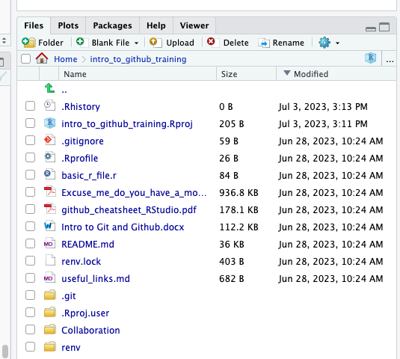
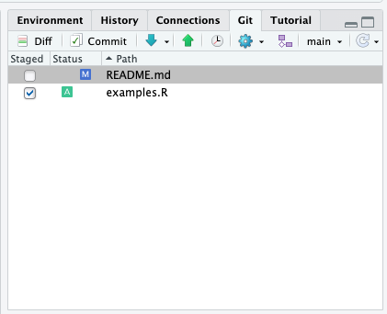
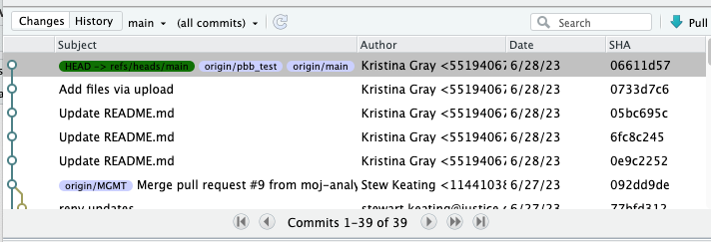
File states
Save
Working directory
Stage
Staging area
Commit
Commit history
?
Untracked file – a file that has not yet been staged or committed
M
Modified file
A
File added to the staging area
D
Deleted file
R
Renamed file
Notes:
View the working directory in the files pane
View the staging area in the git pane
View the commit history in the git history window

Slide 13
File states
git add
git commit
Save
Working directory
Stage
Staging area
Commit
Commit history
git status
git status
git log
Notes:
To view the state of the working directory and staging area: git status
To view the commit history: git log
To stage files: git add
To commit everything in the staging area: git commit

Slide 14
3. Walk-through of the basic Git workflow

Slide 15
Graphical user interface (GUI)

Slide 16
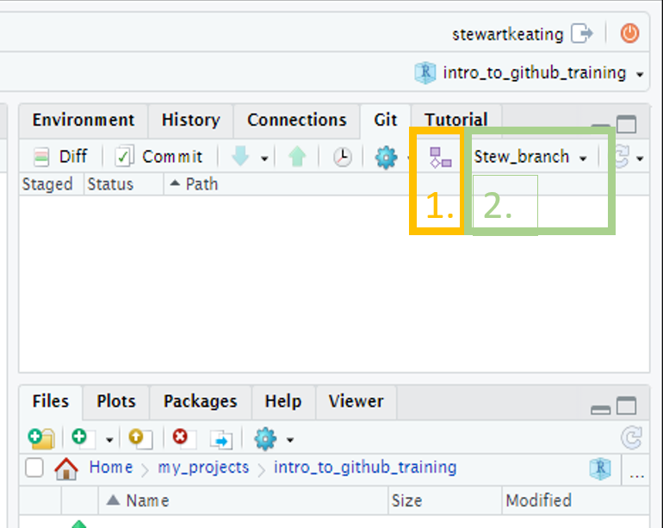
Create a branch
GUI
Create a branch: click the “Git” tab on the right of R-Studio, then the small purple shapes on the right of the screen, add a branch name, and click create.
A pop-up will appear with a message that you have switched to a new branch, and the branch name will update in the Git pane. You can just close the pop-up.
(Note that if the “Sync branch with remote” checkbox is ticked the branch will also be created on the remote GitHub repo, removing the need to do that manually at a later stage.)

Slide 17
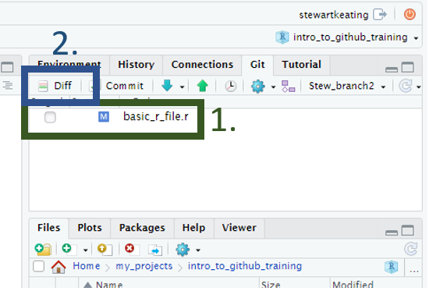
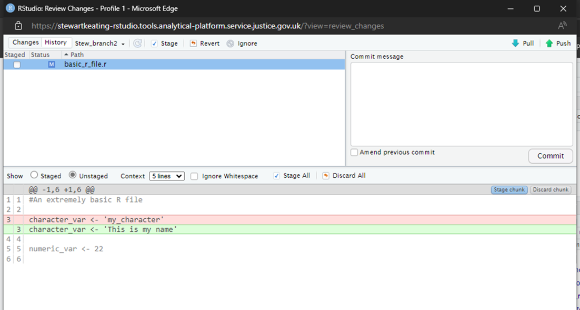
Edit some files, for example write some code to an R script
GUI
If using the GUI, any files that have been edited and saved will appear in the git tab on the right-hand side of the screen. You can view the changes by pressing the Diff button and selecting the file name. Lines highlighted in red have been removed; lines highlighted in green have been added. Lines written in grey have not been changed. The left margin shows the line numbers of the code that has changed.

Slide 18
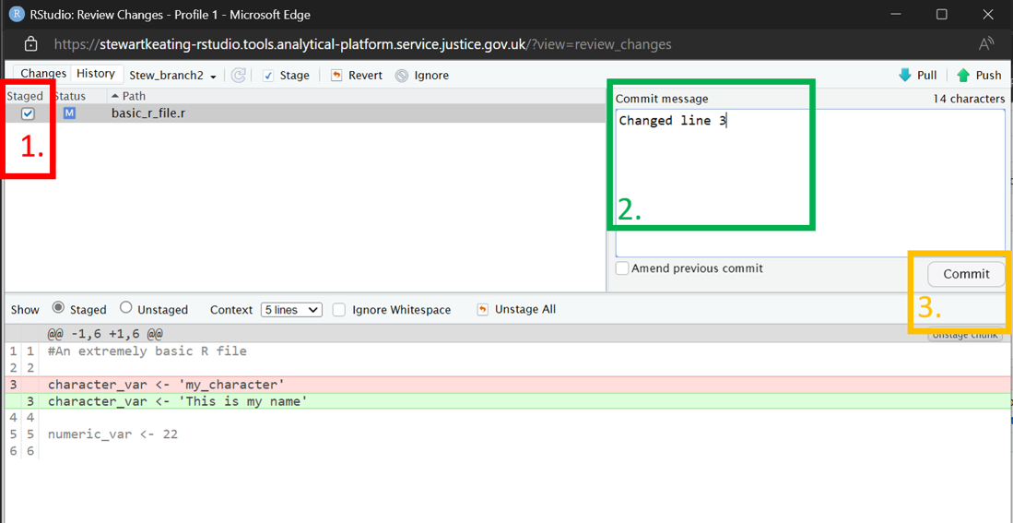
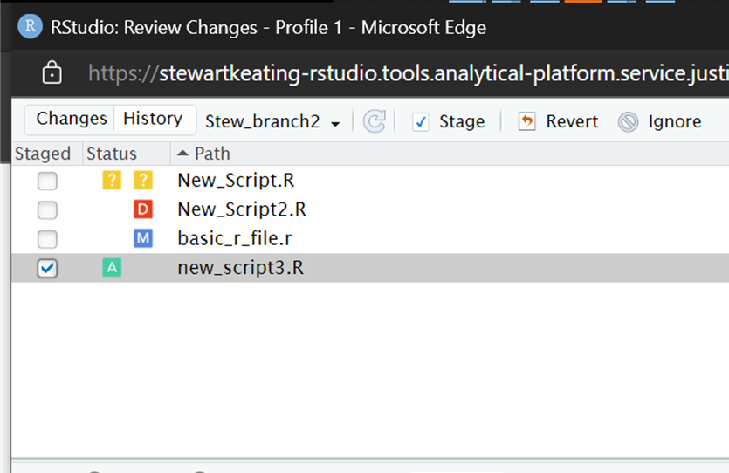
Stage and commit a group of changes
GUI
Click either Diff or Commit to open the Review changes pop-up.
To stage a file, click the check box by the file name. Stage every file whose changes you would like to include in the commit.
Add a commit message in the commit message box.
Click the Commit button.
Changes to files can be seen in the status column.
?
An untracked file – a file that has not yet been staged or committed.
M
A file that has been modified
A
A file that has been added to the staging area.
D
A file that has been deleted.
R
A file that has been renamed.
In this example, the previous line 3 has been replaced by a new line 3.

Slide 19
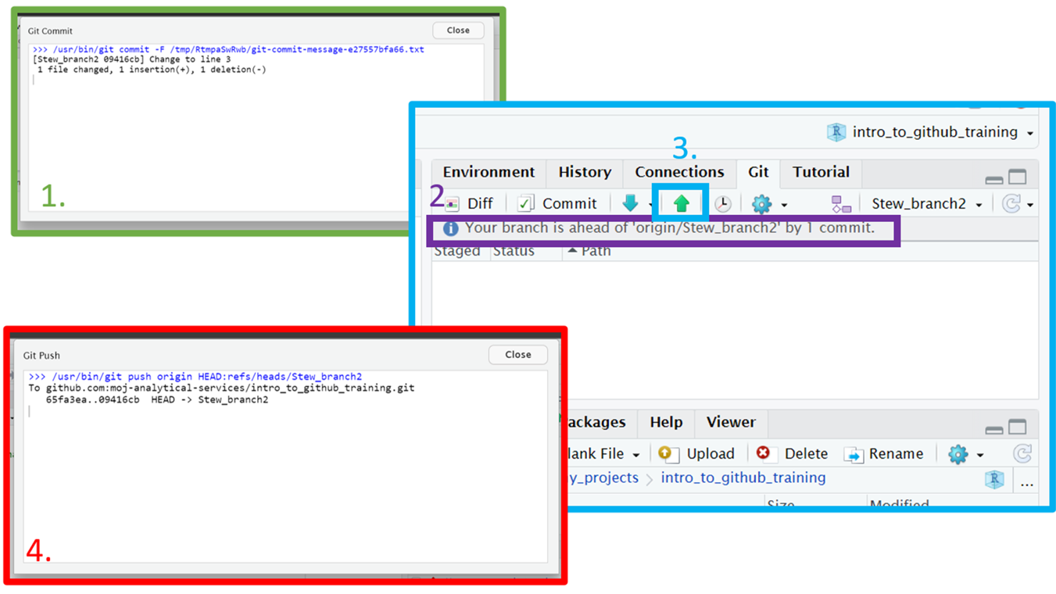
Push changes
GUI
After committing, you will see a pop-up listing any changes, additions, deletions and the commit message.
Back on the main RStudio screen, you can see how commits ahead of the remote GitHub repo you are.
To push your changes to GitHub, click the up arrow.
You will see another pop-up confirming your branch has been updated on GitHub.

Slide 21
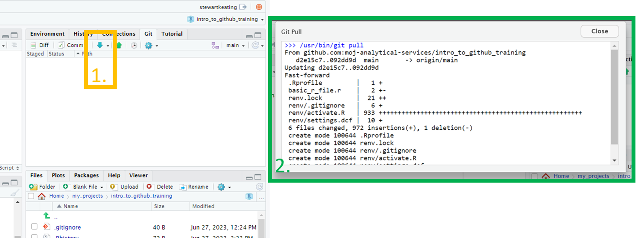
Pull changes into a local branch
GUI
After the merge has been accepted on GitHub, use the down arrow (next to the push arrow) to pull in the changes on GitHub.
A pop up will appear showing the changes.
In the GUI example screen shots, StewBranch2 was merged with Main branch. The local copy of Main Branch in R-Studio was updated by pulling the changes to Main Branch from GitHub.

Slide 22
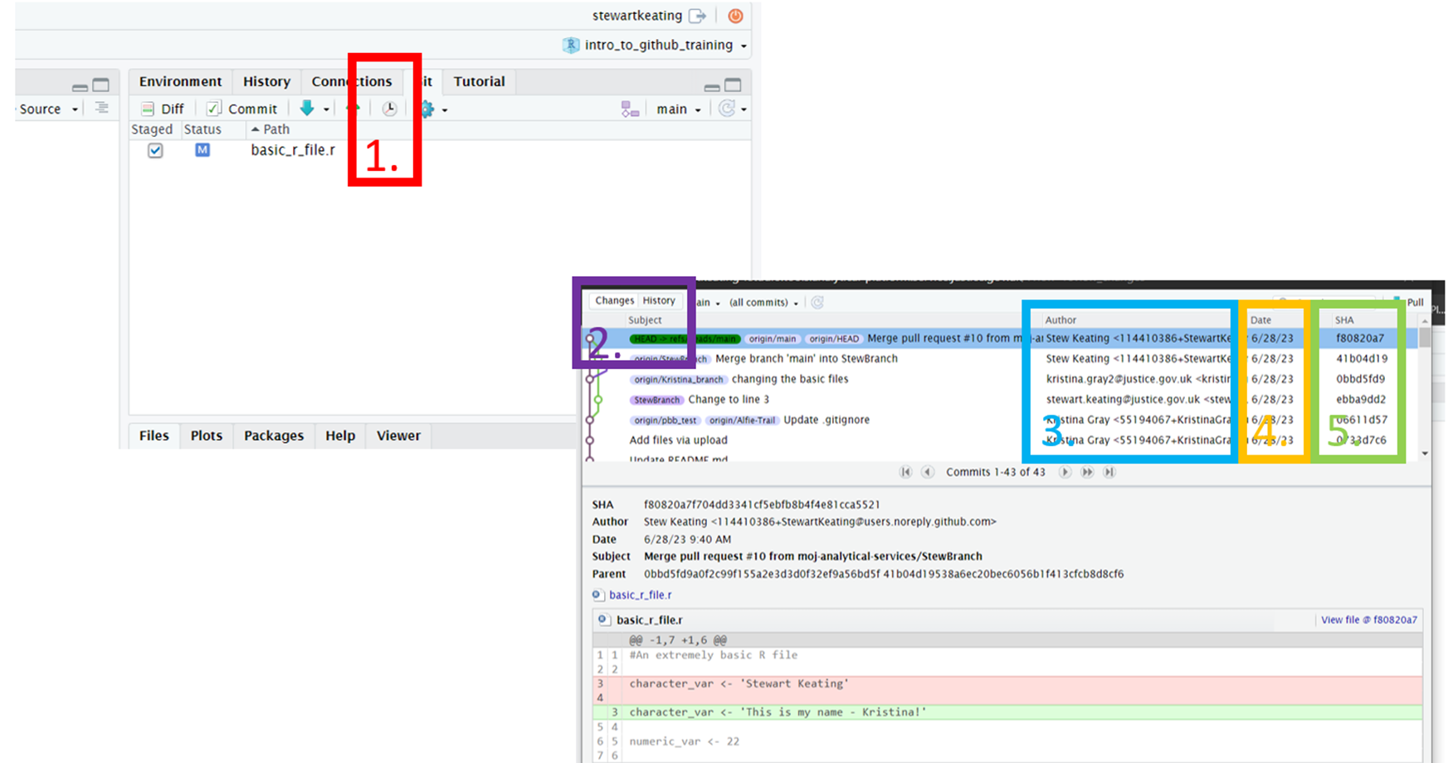
View the commit history
GUI
In the Rstudio Git pane, click on “History” to see the commit history for the current branch.
We can switch between the DIFF/COMMIT or HISTORY pop ups
3. The author of the commit
4. The date the commit took place
5. The unique ID for the commit

Slide 23
Create a branch
Terminal
Use the git status command before you create a new branch. git status displays the current state of your files and the staging area: what branch you’re on and which files have been modified or staged since the last commit.
To create a new branch:
git checkout –b my_branch

Slide 24
Edit some files, for example write some code to an R script
Terminal
In the terminal, git status displays the current state of your files and the staging area.
You can also use the git diff command to show changes. Typing the command without any options shows the uncommitted changes since the last commit.

Slide 25
Stage and commit a group of changes
Terminal
Use git add to add files to the staging area.
To stage a single file:
git add my_file.txt
To stage all modified files:
git add .
Use git commit to commit the staged files.
To commit the staged files and open a text editor in which to type the commit message:
git commit
To commit your changes and type an inline commit message (instead of opening the text editor):
git commit -m "My commit message"

Slide 26
Terminal commands

Slide 27
Push changes
Terminal
Use git push to push your branch to the remote repo.
To push to a branch that already exists on the remote repo:
git push
If your branch does not yet exist on the remote GitHub repo, the first time you push you will need to create a remote version:
git push –u origin my_branch
The option -u is a shortcut for --set-upstream, which creates a version of the branch on the remote repo.

Slide 28
Pull changes into a local branch
Terminal
If you are not currently on the main branch, switch to it with:
git checkout main
Use the git pull command to merge commits added to the remote branch into your local branch.

Slide 29
View the commit history
Terminal
The git log command shows the commit history for the current branch, starting with the most recent. The --oneline option is useful to condense the output. You can limit the number of commits shown with the – option.
For example, to see the most recent five commits on the current branch :
git log --oneline -5

Slide 30
Practice
1. Clone the course repository and create a new branch
If you have not done so already, clone the course repo by following the steps in the set-up section at the start of this document.
Create a branch with any name you choose.
2. Create and edit a file and commit the changes
Create a new folder within ‘practice_folder’ and then create a new R script within the folder. Write something in the R script. Press ‘save’ to save the script.
Add the changes to the ‘staging area’ and then commit them. Add a commit message that briefly describes the changes you have made.
3. Push the changes to Github
Now that you have committed your changes to the local version of your new branch, push the updated branch to the remote Github repo.
4. Open a pull request on GitHub and merge
Navigate to the GitHub repo and open a pull request to merge your branch into main.
Merge the branch using the option at the bottom of the pull request page.
5. Pull the updated version of the main branch into your local version of the repo
In RStudio, switch to the main branch. Look in the file pane and note that files you made in your new branch are not shown. You might get a dialogue box asking you if you want to close open files that are not in the main branch.
Pull changes from GitHub and notice that the file pane updates to include files from the new branch.
Check the commit history to see that your commits are now part of the main branch.

Slide 31
4. Advanced topics

Slide 32
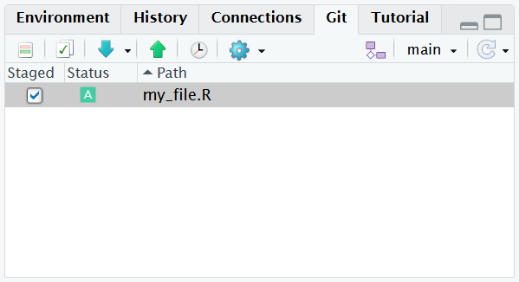
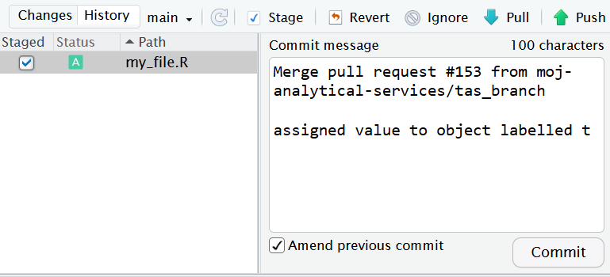
Undoing changes
Unstage everything (keeps your files as they are, just clears the staging area):
git reset
Amend the previous commit (add the staged changes to the previous commit – only do this if not pushed)
git commit --amend
Revert the previous commit (creates a new commit that undoes it - safe if you already pushed)
git revert HEAD
Notes:
You can unstage a file using the Rstudio GUI - untick the checkbox by the filename in the Git pane.
You can also amend the previous commit using the GUI - stage the changes you want to make and click on “commit”, but before typing a commit message, tick the “Amend previous commit” checkbox.
There is no option to revert a commit using the GUI.

Slide 33
Merge conflicts
<<<<<<< HEAD
# Code change from the destination branch
=======
# Conflicting code change from the incoming branch
>>>>>>> incoming_branch
The code between <<<<<<< and ======= is the destination branch – the branch you are merging into.
The code between ======= and >>>>>>> is the code in the incoming branch.
To resolve:
Edit the code to contain the final version.
Delete the conflict markers (<<<<<<<, =======, >>>>>>>).
Stage the file and commit.
Notes:
A merge conflict occurs when both branches have changed the same lines in a file

Slide 34
Resolving merge conflicts in practice (more advanced)
In practice:
If there is a conflict between your feature branch and main, you usually resolve it on the feature branch in your local repo, by merging main into the feature branch.
You then push the updated feature branch version to GitHub, where it can be merged into main via a PR now that the conflict has gone.
The workflow is:
While on your feature branch, merge the main branch: git merge main
This updates your feature branch to include any new code in main.
If there are conflicts, Git tells you. You resolve them and then make a commit to allow the merge to complete.
You then push your updated branch to GitHub: git push feature_branch
If you already have a PR open, the PR will update automatically.
This becomes clearer once you have done it a few times.

Slide 35
Stashing changes
To temporarily store your work without making a commit:
git stash
Useful if you need to switch branches but aren’t ready to commit yet.
To re-apply the stashed changes:
git stash apply
(Alternatively, git stash pop is like apply but also removes the stash entry.)

Slide 36
5. Effective collaboration

Slide 37
Good practice
Make small and self-contained commits
Clear commit messages
Small branches and regular merges
Pull request descriptions
Branch protection rules
Delete merged branches
Document your repository

Slide 38
6. Security considerations

Slide 39
Good practice
Repository visibility
Storing data
Git ignore files

